Slide 1


SHOCKLESS TOUCH AUTOMATION
TEAM MEMBERS:
VISHNURAM T (19BEC4236)
SATHEESHKUMAR N(19BEC185)
SATHEESHKUMAR SB (19BEC4188)
SRIPATHI R (19BEC4206)
Dr. C.Nandhagopal
AP/ECE

Slide 2
LIST OF CONTENT
Abstract
Objective
Block Diagram
Circuit Diagram
Components and its Cost

Slide 3

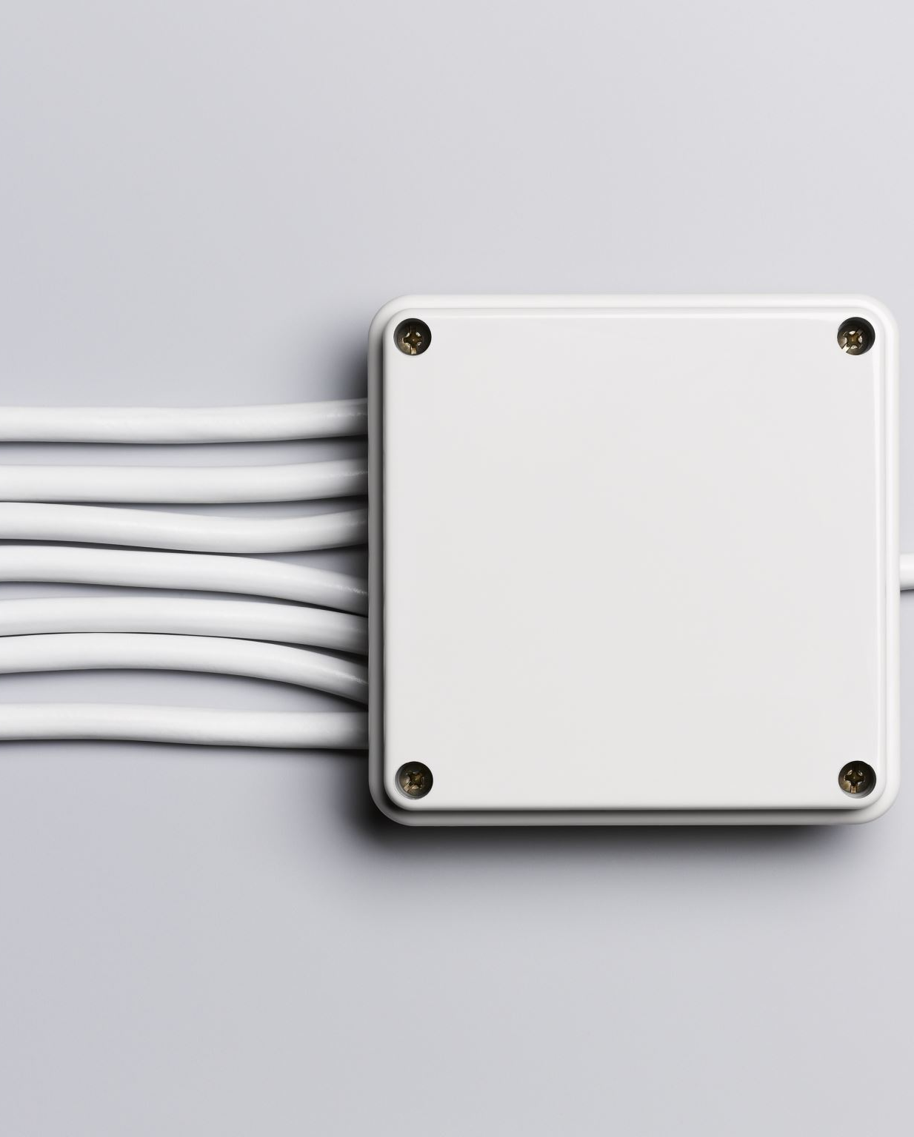
ABSTRACT
To Control the home appliances and industrial appliances by avoiding electric shock.
Touch sensor is used to control the appliances.

Slide 4

OBJECTIVE
The main objective of this project is to control home appliances to avoid the dangerous of electric shock.

Slide 5
BLOCK DIAGRAM
POWER SUPPLY
INDICATOR
RELAY MODULE
TOUCH PANEL
LOAD

Slide 6
CIRCUIT DIAGRAM
BULB
INPUT OR OUTPUT SIGNAL
P
TOUCH PANEL
RELAY
VCC
VCC
N
N
AC MAINS
5V POWER SUPPLY
P
230V

Slide 7
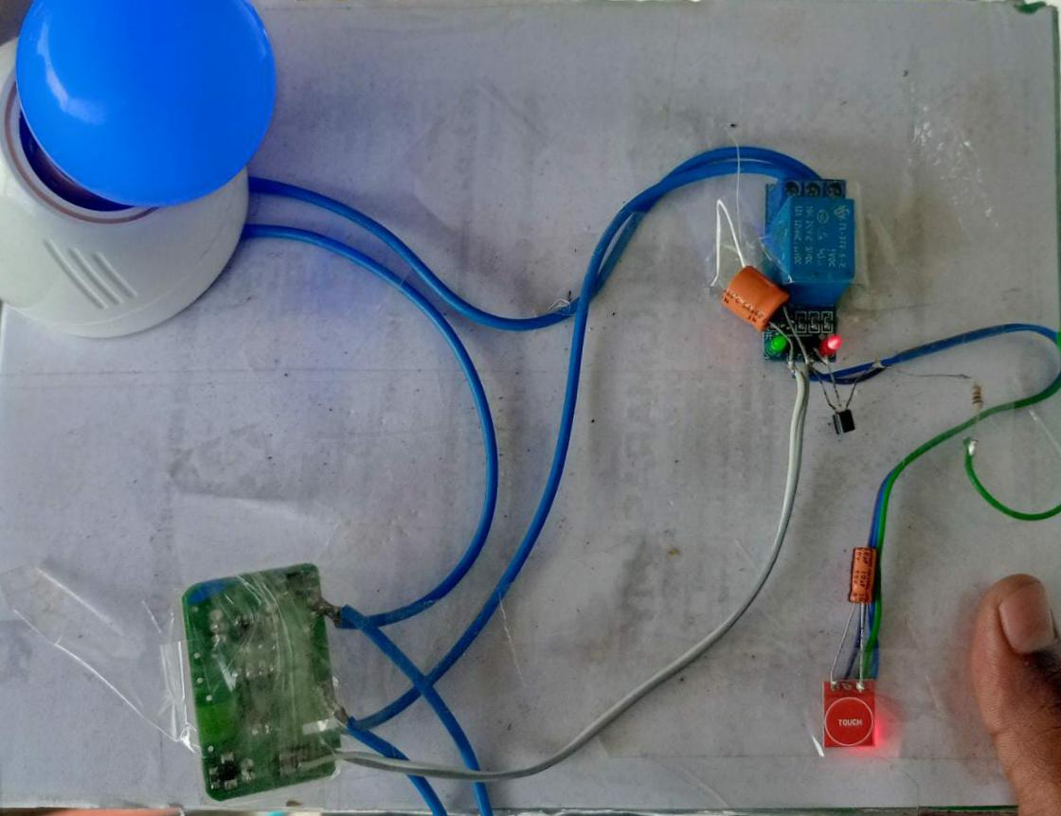
Project image

Slide 8

Advantages
Industrial Safety
Fire Safety
Power consumption
Shockless switch

Slide 9

Features
Fast working techniques.
Simpely designed and user friendly switches.
High speed switching without any delays.

Slide 10
COMPONENTS AND ITS COST
COMPONENTS | COST
Touch Sensor | 110
Relay Module | 150
5V Adaptor | 200
Bulb | Based on Watts
Bulb holder | 25
Jumper Wires | 25

Slide 11


